Slide 1
Entrepreneurship
Becoming an Entrepreneur

Slide 2
Characteristics of Entrepreneurs
Entrepreneur – someone who takes a risk in starting a business to earn a profit
Being your own boss
Developing a good initial plan
Special skills and abilities and coming up with innovative ideas
Entrepreneurship – the process of starting, organizing, managing, and assuming the responsibility for a business

Slide 3
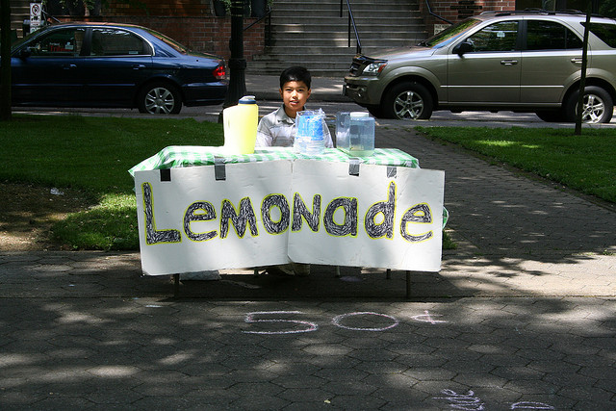
What Does it Take?
Not all business owners and managers are entrepreneurs.
Entrepreneurs have unique skills and personal characteristics.

Slide 4
Entrepreneurs Are:
Persistent
Inquisitive
Energetic
Goal-oriented
Independent
Self-confident
Creative
Reliable
Competitive

Slide 5
Checkpoint #1
What personal characteristic are common to most successful entrepreneurs?
persistence, inquisitiveness, self-confidence, creativity, and so forth.

Slide 6
Opportunities and Risks
Before deciding to start a business, you need to think about the opportunities and risks.
New Business Opportunities
Innovation – an invention or creation that is brand new
Improvement – a designed change that increases the usefulness of a product, service, or process

Slide 7
Opportunities and Risks
Recognizing Risks
The primary reasons that businesses started by entrepreneurs close are:
Lack of adequate capital
Low sales
Higher than expected expenses
Competitive pressure
An owner unprepared to manage a growing business
Operations requiring more time than the owner is willing to commit

Slide 8
Checkpoint #3
Where do entrepreneurship opportunities begin?
Opportunities begin with innovations (ideas about new products and services) or improvements (ideas for changes to existing products, services, or processes).

Slide 9
Common Small Business Problems
Reasons for failure
Not keeping adequate records
Not having enough start-up money
Lack of management experience
Lack of experience with the type of business
Not controlling operating expenses
Poor location for the business
Failure to manage credit offered to customers

