Slide 1
Wireless Sensor Networks: 6LowPAN&RPL
Sedat Görmüş, PhD
Source presentations :
Jurgen Schonwalder, Internet of Things: 802.15.4, 6LoWPAN, RPL, COAP
Siarhei Kuryla, RPL: IPv6 Routing Protocol for Low power and Lossy Networks

Slide 2
Outline
PHY Layer
PHY Layer Technologies
RF Technology Overview
Channel Coding
Modulation
Wireless Channel Effects
PHY Standards

Slide 3
PHY Layer for WSNs: What is it?
The physical (PHY) layer is responsible for the conversion of bit streams into signals that are best suited for communication across the wireless channel.
PHY layer is responsible for;
Frequency Selection
Carrier Frequency Generation
Signal Detection
Modulation/Demodulation
And Encryption
Wireless Communication has several advantages such as;
Ease of deployment
Almost infrastructure networking
Mobility
And to some extend having broadcast properties.
But it also has giant challenges such as;
High energy consumption and complex tranceiver design
Wireless channel is a challenging medium ( Signal decays as d^2, multipath, fading effects.)
Notes:
The physical (PHY) layer is responsible for the conversion of bit streams into signals that are best suited for communication across the wireless channel. More specifically, the physical layer is responsible for frequency selection, carrier frequency generation, signal detection, modulation, and data encryption. The reliability of the communication depends also on the hardware properties of the nodes, such as antenna sensitivity and transceiver circuitry.

Slide 4
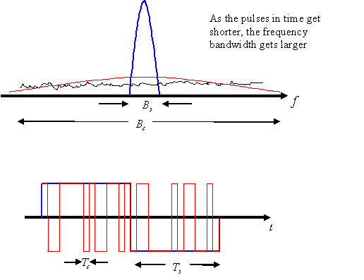
PHY Layer Technologies
Narrow band communication
The data is sent via a narrow band RF signal using FSK modulation.
Spread Spectrum Communications
to improve the data rate and resistance to interference.
A narrow-band signal is transmitted using a spectrum that is much larger than the frequency content of the signal.
the signal at a particular band is observed as noise, which improves the resilience to interference from other signals
UWB Communications
UWB employs baseband transmission and, thus, requires no intermediate or radio carrier frequencies.
Generally, pulse position modulation (PPM) is used.
When we compare these techniques;
We see that Narrow band technique performs badly in WSN since they are not very energy efficient.
On the other hand spread spectrum is resilient against narrow band signals.
UWB significantly improves the energy efficiency and resilliency to interference, but it is limited to smal ranges (typically 10 meters).
Notes:
Spread-spectrum techniques have recently been used for RF communication to improve the data rate and resistance to interference. A narrow-band signal is transmitted using a spectrum that is much larger than the frequency content of the signal. In other words, a signal of limited bandwidth is spread over a much larger band using spread-spectrum techniques. Accordingly, the signal at a particular band is observed as noise, which improves the resilience to interference from other signals. Two types of spread-spectrum techniques exist: frequency hopping spread spectrum (FHSS) and direct sequence spread spectrum (DSSS).
FHSS relies on a frequency hopping scheme, where the wide-band spectrum is divided into frequency channels. Accordingly, the transmitter and receiver pair hops through these channels based on a predefined hopping scheme. FHSS has been mainly used in the Bluetooth standard [3]. The µAMPS wireless sensor node [26] uses a Bluetooth-compatible 2.4 GHz transceiver with an integrated frequency synthesizer.
On the other hand, DSSS is based on pseudo-noise (PN) codes that are called chips. A stream of chips is used to modulate the information bits to be sent. The chips have a much smaller duration compared to a bit and, hence, each bit is modulated with a number of chips. Since the chip rate is much higher than the bit rate, the narrow-band information is again spread over a much larger bandwidth. By communicating the sequence of PN codes to the receiver, a DSSS signal can be decoded. The DSSS technique has become the de facto standard for WSNs with the establishment of the IEEE 802.15.4 standard [4]. Accordingly, many recent sensor platforms including MicaZ, TelosB, and Imote2 employ the DSSS technique. The CC2420 transceiver chip, which is used in these platforms, operates at the 2.4 GHz band with a chip rate of 2 Mchips/s and a bit rate of 250 kbps.
Akyildiz, Ian F.; Can Vuran, Mehmet (2011-07-26). Wireless Sensor Networks (Advanced Texts in Communications and Networking) (Kindle Locations 1957-1966). Wiley. Kindle Edition.

Slide 5
PHY Layer Technologies
Optical (Infrared) Communications
takes place in the band that is at the lower end of the visible spectrum
Infrared communication has been used mainly for short-range communication
Infrared signal can travel long distances with a very low power and simple tranceiver design.
But suffers from interference from Sun in outdoor environments.
Acoustic Communications
The environment dicdates the type of PHY used in WSNs.
Acoustic communications are mostly used for underwater wireless sensor networks.
RF and Light are limited in underwater environments where acoustic vawes can travel long distances.

Slide 6
PHY Layer Technologies
Magnetic Induction Communications
WSNs have also been recently deployed in underground settings,
Where RF communication is severele limited by soil and rock formations and water content in the soil.
Magnetic induction is not affected by such conditions hence a suitable candidate for Wireless Underground Sensor Networks(WUSN).
The content of the soil has very limited impact on the Magnetic Induction, But, the range of the communication is quite limited.
Notes:
WSNs have also been recently deployed in underground settings, where communication is severely affected by underground obstacles such as soil, rocks, and tunnels. This led to the development of wireless underground sensor networks (WUSNs). Traditional signal propagation techniques using EM waves encounter three major problems in the soil medium [7]. Firstly, EM waves experience high levels of attenuation due to absorption by soil, rock, and water underground. Secondly, the path loss is highly dependent on numerous soil properties such as water content, soil makeup (sand, silt, or clay), and density, and can change dramatically with time and space. Thirdly, operating frequencies in the megahertz or lower ranges are necessary to achieve a practical transmission range [6]. To efficiently transmit and receive signals at that frequency, the antenna size would be too large to be deployed in the soil. Magnetic induction (MI) is an alternative signal propagation technique for underground wireless communication, which addresses the challenges of dynamic channel condition and large antenna size in the EM wave techniques. In particular, dense media such as soil and water cause little variation in the attenuation rate of magnetic fields from that of air, since the magnetic permeabilities of each of these materials are similar. Details of communication through magnetic induction techniques are deferred to Chapter 17 in the explanation of WUSNs.
Akyildiz, Ian F.; Can Vuran, Mehmet (2011-07-26). Wireless Sensor Networks (Advanced Texts in Communications and Networking) (Kindle Locations 2046-2056). Wiley. Kindle Edition.

Slide 7
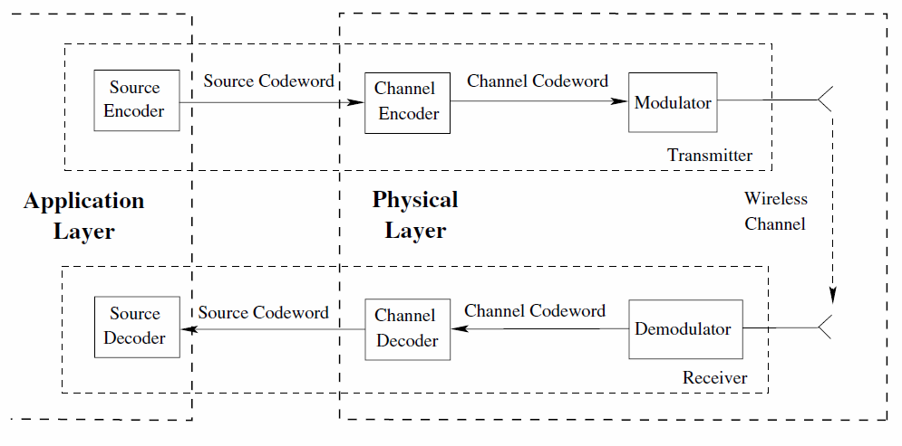
RF Wireless Communication

Slide 8
RF Wireless Communication (Transmitter)
Source coding (data compression): At the transmitter end, the information source is first encoded with a source encoder.
It exploits the information statistics to represent the source with a fewer number of bits.
Source coding is also referred to as data compression.
Source (en/de)coding is performed at the application layer.
Channel coding (error control coding): The source codeword is then encoded by the channel encoder to address the wireless channel errors affecting the transmitted information.
Channel coding is also referred to as error control coding.
Interleaving and modulation: The encoded channel symbols are then interleaved to combat the bursty errors that can affect a large number of consecutive bits.
The channel coding and the interleaving mechanism help the receiver either to;
(1) identify bit errors to initiate retransmission
(2) correct a limited number of bits in case of errors.
Then, an analog signal (or a set thereof) is modulated by the digital information to create the waveform that will be sent over the channel.
Finally, the waveforms are transmitted through the antenna to the receiver.

Slide 9
RF Wireless Communication (Receiver)
Wireless channel propagation: The transmitted waveform, which is essentially an EM wave, travels through the channel.
Meanwhile, the waveform is attenuated and distorted by several wireless channel effects.
Deinterleaving and Demodulation: At the receiver end, symbol detection is performed first to lock into the sent waveform
The received signal demodulated to extract the channel symbols.
Then de-interleaved and decoded to recover the source information.
Notes:
The limited energy resources and the low cost requirements of the WSN paradigm result in low-power communication techniques being employed.
Furthermore, high-complexity channel codes, modulation schemes, or antenna technologies cannot be employed.
These limitations exacerbate the effects of the wireless channel. Consequently, providing energy-efficient wireless communication is a major challenge for the PHY layer of WSNs.

Slide 10
RF Wireless Communication (Source Coder)
The first step in information delivery in wireless systems is source coding (or data compression).
These solutions rely on the statistical characteristics of information for more efficient representation.
Accordingly, redundant information is compressed to decrease the data volume while preserving the information content.
Source coding is generally performed at the application layer. (will be discussed later)

Slide 11
Channel Coding (Error Control Coding)
Once the data source is encoded, this information needs to be transmitted reliably over the wireless channel.
But, wireless channel varies over the time and the transmitted data gets corrupted.
We need mechanisms to reliably transmit data over the wireless channel.
The main goal of the channel coding approaches is to exploit the statistical properties of the wireless channel to inject redundancy into the information to be sent.
Consequently, the received information can be decoded successfully even if certain portions of it are distorted.
This notion can be clearly understood from the figure
Notes:
The redundant bits (or parity bits) are added to the source codeword to create the
channel codeword, which helps combat the wireless channel errors. Note that the resulting channel word
may be longer or shorter than the initial information since source and channel coding are performed
independently. As a result, the reduction due to source coding depends on the properties of information
content whereas the increase due to channel coding depends on the channel properties

Slide 12
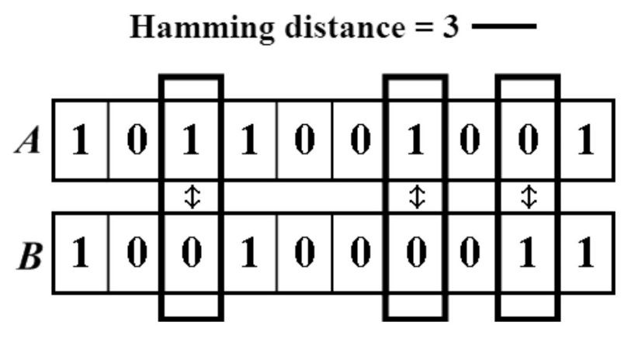
Block Codes
Block codes are generally preferred in WSNs due to their relatively simpler implementation and smaller memory requirements.
A block code transforms an input message u of k bits into an output message v of n bits, n> k.
Depending on the complexity of the code, each code is capable of correcting up to t bits in error.
Accordingly, a block code is identified by a tuple (n, k, t).
The error detection and error correction capabilities of block codes are determined by the minimum distance of the code.
The Hamming distance between two codewords is defined as the number of places they differ.
Notes:
Accordingly, the minimum Hamming distance, dmin, is the minimum distance between any two words in a code.
A code with minimum distance dmin can detect up to dmin − 1 errors and
correct up to t errors such that 2t + 1 ≤ dmin ≤ 2t + 2

Slide 13
Block Codes (BCH, RS and CRC)
BCH code is block code which is suitable for WSNs due to its low memory requirement.
A BCH code is identified by a tuple (n, k, t )
where n is the block length, k is the information length, and t is the maximum number of errors that can be corrected
RS (Reed–Solomon) codes are a family of BCH codes that are non-binary, i.e., the operations are performed in GF(q), where q is a prime number.
CRC (Cyclic Redundancy Check) codes are a special family of BCH codes that are used to detect errors in a packet.
Irrespective of whether an error control code is used within communication, CRC codes are used in almost any communication system.
The automatic repeat request (ARQ) scheme, which relies on retransmissions for reliability, is based on CRC codes.
CRC codes detect whether a packet is received in error or not. However, they cannot correct these errors.

Slide 14
Modulation
The radio communication happens in analogue domain, hence the digital information needs to be modulated into waveforms.
The conversion from source encoded bit stream into waveform is accomplished by modulation techniques.
A typical modulation waveform is a sinusoid and given as ;
$s\left(t\right)=r\left(t\right)\cos\left[2πf_{c}t+ ω\left(t\right)\right]$
Where r(t) is the amplitude, fc is the centre frequency of the waveform and w(t) is the phase of the waveform.
Digital information is transmitted by modifying one of these components according to the bits to be transmitted.
This notion leads to three basic modulation approaches.
Amplitude shift keying (ASK)
Frequency shift keying(FSK)
Phase shift keying(PSK)

Slide 15
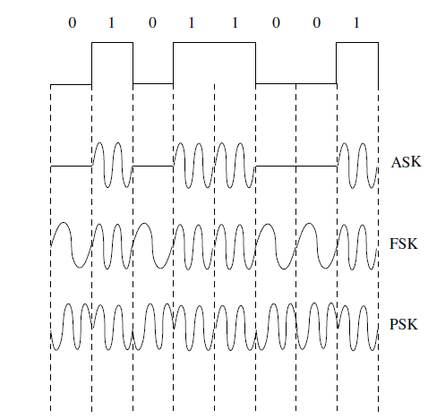
Modulation
ASK : the ASK modulation scheme is based on modulating the amplitude of the waveform according to the bit to be sent.
The simplest form of ASK is ON–OFF keying (OOK), which transmits a waveform for a digital 1 and keeps silent for the duration of a digital 0.
A simple signal amplitude comparison is performed at the receiver to detect the transmitted bits.
FSK: it is one of the most frequently used modulation schemes for wireless communication.
As shown here, the frequency, fc, of the waveform is varied based on the information bit to be transmitted.
By choosing distant frequency values, different signals and hence bits can be detected at the receiver.
PSK: it is based on modifying the phase of the waveform, ψ(t), according to the transmitted bits as shown.
Accordingly, the changes in the phase of the received signal can be mapped to the transmitted bits at the receiver.
Notes:
The modulation schemes used for wireless communication are generally derived from the three main
schemes shown in here.
Next, we describe two main modulation schemes used for WSN platforms:
frequency shift keying (FSK) and offset quadrature phase shift keying (OQPSK).
The energy efficiency of modulation schemes is also discussed.

Slide 16
Main Modulation Schemes for WSNs
Two main modulation schemes are used for WSNs namely FSK and OQPSK
FSK is used by early WSN platforsm such as Mica2.
As we discussed earlier, bit stream is represented different frequency values. Let’s say f1 for ‘0’ and f2 for ‘1’.
At the receiver the wave form is passed through two matched filters that are tuned to frequencies f1 and f2.
The output of each filter represents the signal content at the particular centre frequency.
BER for FSK is given as ;
$P_{b}^{FSK}= \frac{1}{2}\exp\left(−\frac{E_{b}}{2N_{0}}\right)$
$\frac{E_{b}}{2N_{0}}$ is the energy per bit to noise spectral density, which represents the quality of the signal received.
Notes:
which is input to an envelope detector. The results of the envelope detector are compared for a decision.

Slide 17
Main Modulation Schemes for WSNs
OQPSK stands for Offset Quadrature Phase Shift Keying. And it is the most popular modulation scheme for modern WSN.
Modulation of bits in an IEEE 802.15.4 transceiver uses offset QPSK (O-QPSK) with DSSS.
The modulation structure is shown in the figure,
it consists of the conversion of bits to symbols, conversion of symbols to chips, and O-QPSK modulation for the chips.
In the IEEE 802.15.4 standard, a byte is represented by two symbols with 4 bits per symbol, which results in a 16-ary modulation.
Each 16 symbol is represented by a combination of 32 chips.
Then, each chip is transmitted using O-QPSK modulation.

Slide 18
Thank You for Your Attention.

