Slide 1
Wireless Sensor Networks: Transport Layer & Research
Sedat Görmüş, PhD

Slide 2
Outline
Transport Layer
Challenges for Transport Layer
Reliable Multi-Segment Transport (RMST) Protocol
Congestion Detection and Avoidance (CODA) Protocol
Application Layer
Source Coding (Data Compression)
Query Processing
Network Management
Grand Challenges
Integration of Sensor Networks and the Internet
Real-Time and Multimedia Communication
Protocol Stack
Synchronization and Localization
WSNs in Challenging Environments
Wireless Nano-sensor Networks

Slide 3
Transport Layer

Slide 4
The Main Objectives of Transport Layer in WSN are
Congestion control: Packet losses due to congestion can impair reliability at the sink even when enough information is sent out by the sources.
Reliable transport: Based on the application requirements, the extracted event features should be reliably transferred to the sink (and controls in the opposite direction).
(De)multiplexing: Different applications can be served on sensor nodes through the same network. The transport layer should bridge the application and network layers by using multiplexing and de-multiplexing.
Notes:
1) Hence, congestion control is an important component of the transport layer to achieve the required reliability. Furthermore, congestion
control not only increases the network efficiency, but also helps conserve scarce sensor resources.
2) Similarly, the programming/retasking data for sensor operation, command, and queries should be reliably delivered to the target sensor nodes to assure the proper
functioning of the WSNs.
There exist several transport layer solutions developed for conventional wireless networks [3].
Although these solutions may be relevant, they are not suitable for WSNs, In particular, to satisfy the
above objectives and to accommodate the unique characteristics of WSNs, significant modifications
to the existing transport layer protocols are needed. The majority of existing solutions focuses on
reliable data transport following the end-to-end TCP semantics and addresses the challenges posed by
wireless link errors and mobility [4].

Slide 5
Challenges for Transport Layer
End-to-End Measures
How does TCP handle end-to-end reliability?
And why is it not a good idea to use TCP in WSNs?
Application-Dependent Operation
WSNs are deployed with a specific sensing application objective.
For example, a specific phenomenon such as temperature monitoring.
Or, another application may require multiple sensors to carry out event detection.
Different applications have different requirements.
Hence, the design of the transport layer is influenced by the application scenario
Energy Consumption
As always, Energy efficiency is the most important concern in the design of WSNs
This requirement also affects the transport layer design (Can you see why TCP is not such a good candidate from this perspective?)
Notes:
The energy, processing, and hardware limitations of the wireless sensor nodes bring further challenges for the design of the transport layer protocol. The development of transport layer protocols is a
considerable effort because the limitations of the sensor nodes and the specific application requirements primarily determine the design principles. In this respect, the main objectives and challenges of the transport layer are stated next. Moreover, the essential features to address the unique questions posed by the characteristics of the WSNs are also indicated.
1) Conventional transport layer solutions such as TCP adopt end-to-end retransmission-based error control and window-based additive-increase multiplicative-decrease (AIMD) congestion control mechanisms. These mechanisms provide end-to-end and point-to-point reliability and congestion control solutions. More specifically, the packet losses and congestion mitigation are performed through communication between a source and a destination without any involvement from the intermediate parties. Essentially, the transport control mechanisms reside only on the source and destination. Furthermore, each flow is considered independently to provide a point-to-point communication solution.
These end-to-end control mechanisms used for conventional transport layer protocols usually lead to resource wastage in WSNs, where collective information from a group of sensors is much more important than the individual information from each sensor node. Therefore, conventional end-toend, point-to-point transport layer techniques may lead to waste of scarce wireless sensor resources. Instead, local measures for reliability and congestion control are usually exploited to improve the energy efficiency of the transport layer protocols. Similarly, reliability of the collective information from a group of sensors is controlled instead of the reliability of information from each individual sensor node.
2) Thus the focus of the transport layer solutions should be tailored to the application. Moreover, the application can be developed for a wide range of purposes in the military, environment, health, space exploration, and disaster relief areas.
3) Scarce energy resources affect the design of transport layer solutions. Consequently, the transport layer functionalities should be energy aware, i.e., the error and congestion
control objectives must be achieved with the minimum possible energy expenditure. For instance, if reliability levels at the sink are found to be in excess of that required for event detection, the source nodes can conserve energy by reducing the amount of information sent out or temporarily powering down. Similarly, end-to-end measures, which are successfully used for conventional networking for reliability, usually require significant energy consumption in a multi-hop network.

Slide 6
Challenges for Transport Layer
4. Biased Implementation
WSNs are usually deployed with a large number of resource-constrained sensor nodes that are connected to a resource-rich sink.
The limited processing power and memory capacity of the sensor nodes prevent sophisticated algorithms from being run locally.
Hence, the transport layer algorithms should be designed such that most of the functionalities are performed at the sink with minimum functionalities required at the sensor nodes.
More specifically, the intelligence should be passed to the sink instead of the sensors
5. Constrained Routing/Addressing
As explained earlier, wireless sensor nodes may not be assigned unique addresses.
Therefore,unlike protocols such as TCP, in the design of transport layer protocols for WSNs the existence of an end-to-end global addressing should not be assumed.
It is more likely to have attribute-based naming and data-centric routing, which call for different transport layer approaches.
Notes:
4) Moreover, the traffic in theWSNs exhibits significantly different characteristics depending on the flow direction. While the flow in the sensors-to-sink direction may require timely delivery with loss-tolerant operation, the sink-to-sensors direction usually requires a high delivery ratio. Consequently, transport protocols should be designed also by considering these biases in traffic.

Slide 7
Example WSN Transport Layer Protocol
Reliable Multi-Segment Transport (RMST) Protocol
The RMST protocol is one of the first transport layer protocols developed for WSNs
The main goal of RMST is to provide end-to-end reliability
RMST is built on top of the directed diffusion protocol (If you remeber)[7], and uses some of the functionalities of this protocol.
RMST provides two of the three functionalities required for a transport layer protocol:
Reliable transport and multiplexing/demultiplexing
RMST provides mechanisms to handle errors throughout the routes in the network
RMST utilizes in-network caching and provides guaranteed delivery of the data packets generated by the event flows
Two modes of operation:
Non-caching mode: This mode of operation is very similar to conventional transport layer protocols, where only the source and destination play a role in providing reliability. Consequently, the packet losses are detected at the sink and requested from the source node in an end-to-end fashion through a NACK packet.
Caching mode: In this mode, the intermediate nodes on the reinforced path cache the transmitted packets to decrease the overhead in end-to-end retransmissions.
In RMST, each packet of a flow is labeled by a unique sequence number.
The packet errors are detected whenever there is a hole in the sequence numbers received.
In case of packet errors, nodes request retransmission by sending a NACK packet toward the reverse route from the sink to the sensor.

Slide 8
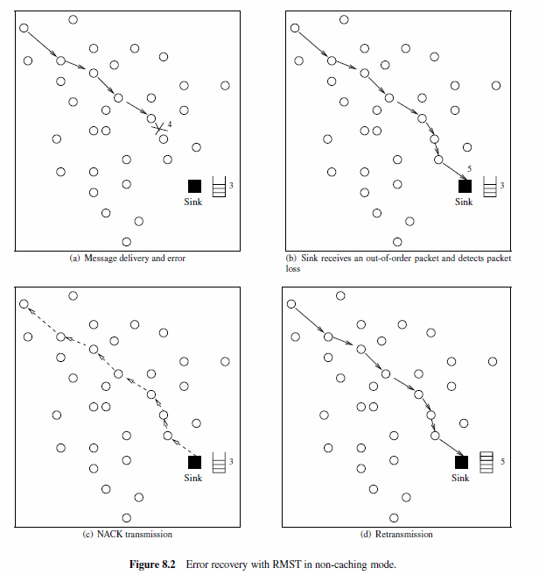
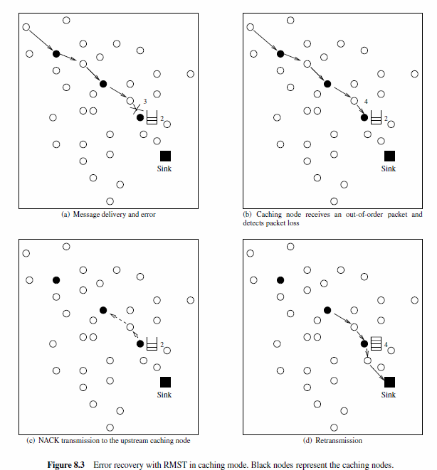
Example WSN Transport Layer Protocol
Reliable Multi-Segment Transport (RMST) Protocol
Notes:
Error recovery in non-caching mode is illustrated in Figure 8.2, where a sensor node is trying
to transmit a series of packets to the sink through the multi-hop route. The sequence number
of the last received packet at the sink is also shown in each case. In non-caching mode, endto-
end retransmissions are performed to provide reliability. In Figure 8.2(a), packet 4 is lost
before reaching the sink. The sink can only recognize the packet loss after it receives packet 5
(Figure 8.2(b)). Then, the sink transmits a NACK packet back to the source node as shown in
Figure 8.2(c). The lost packet is then retransmitted to the sink through the multi-hop route as
shown in Figure 8.2(d).
In caching mode, RMST essentially creates reliable segments between two consecutive caching nodes
and the retransmissions are performed inside these segments instead of through the end-to-end route.
As a result, the cost associated with end-to-end retransmissions is minimized. Moreover, RMST aims to
provide guaranteed delivery for each flow in the WSN. This is helpful for applications where individual
node information is important, such as in network management solutions as discussed in Chapter 9.
RMST may incur additional overhead since caching requires additional processing and memory at the
caching nodes. This may increase the overall complexity and energy consumption of the network. Most
applications related to event detection/tracking may not require 100% reliability since the individual data
flows are correlated and loss tolerant. However, RMST treats each flow separately, which may lead to
overutilization of the resources in WSNs. Moreover, guaranteed reliability via in-network caching may
bring significant overhead for WSNs with power and processing limitations. Finally, RMST focuses

Slide 9
Congestion Detection and Avoidance (CODA) Protocol
The aim of CODA is to detect and avoid congestion in WSNs.
Three main congestion scenarios are considered.
The source nodes frequently generate traffic, congestion builds up close to the source nodes because of the contention in the wireless channel.
For low-rate traffic, congestion can occur temporarily in hot spots, where multiple flows are served.
For these two types of congestion, CODA provides local congestion control mechanisms.
And, because of the topology and the capacity of the network, certain persistent hot spots may exist.
This requires end-to-end mechanisms to regulate the data rate of source nodes.
To address congestion and the different scenarios that cause it, CODA provides three mechanisms via receiver-based congestion detection, open-loop hop-by-hop backpressure signaling to inform the source about the congestion, and closed-loop multi-source regulation for persistent and larger scale congestion conditions.

Slide 10
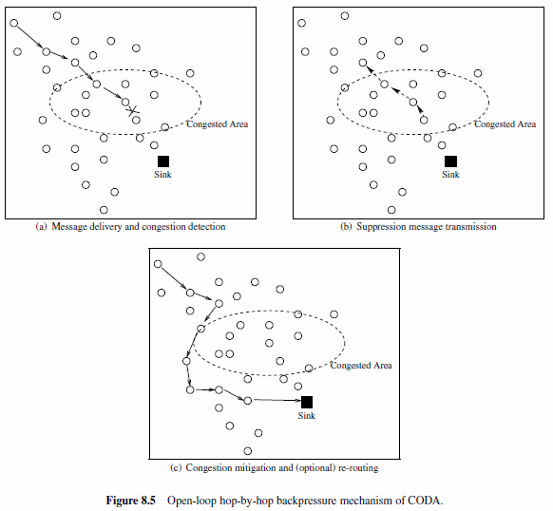
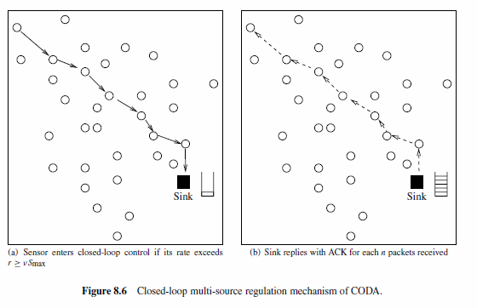
Congestion Detection and Avoidance (CODA) Protocol
Notes:
The congestion mitigation mechanism of CODA is illustrated in Figure 8.5, where a sensor node is trying to transmit a packet to the sink through a congested area. When the congestion is detected
by one of the nodes inside the congested area (Figure 8.5(a)), the receiver broadcasts a suppression message toward the source node in the reverse path as shown in Figure 8.5(b). The suppression message is used to inform the upstream nodes about congestion. Upon receiving the suppression, the upstream nodes decrease their sending rates or drop packets to relieve the congestion in
the forward path. Moreover, the suppression message is rebroadcast until a non-congested node receives the message as shown in Figure 8.5(b). This type of congestion control is referred to as
open-loop hop-by-hop backpressure. Moreover, as shown in Figure 8.5(c), using cross-layer routing techniques the forward path can be rerouted to avoid these hot spots.
In addition to local congestion that may occur as a result of the dynamics in the network, the traffic generated by the source nodes can create network-wide congestion. More specifically, if a source node
injects a traffic load larger than the network can handle, the local congestion control mechanism cannot relieve the congestion. For this case, CODA uses a closed-loop multi-source regulation mechanism
as shown in Figure 8.6. This mechanism is similar to conventional end-to-end congestion control mechanisms. Each source node monitors the source rate, r. If the source rate exceeds a threshold,
r ≥ νSmax, which is a fraction of the maximum theoretical throughput of the channel, the source node enters closed-loop control. In this case, a regulation bit is set in the header of the packets to inform
the sink. Consequently, the sink begins sending periodic ACK messages for each n number of packets received. If the source cannot receive the ACK messages, it determines network-wide congestion and
decreases its source rate.

Slide 11
Application Layer
Notes:
The role of the application layer is to abstract the physical topology of the WSN for the applications.
Moreover, the application layer provides necessary interfaces to the user to interact with the physical
world through the WSN. We will describe the application layer solutions in three categories: source
coding, query processing, and network management. An overview of the application layer protocols is
shown in Figure 9.1.

Slide 12
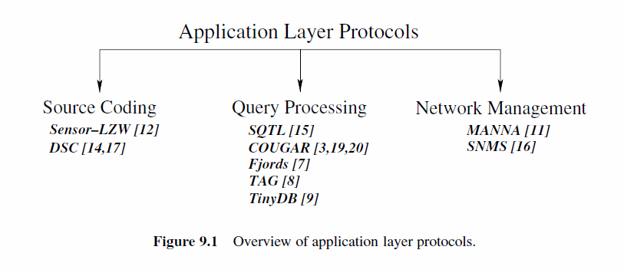
Some Application Layer Protocols
COAP : Constrained Application Protocol

Slide 13
CoAP
The Constrained Application Protocol (CoAP) is a specialized web transfer protocol for use with constrained nodes and constrained networks in the Internet of Things
The protocol is designed for machine-to-machine (M2M) applications such as smart energy and building automation.
Like HTTP, CoAP is based on the wildly successful REST model: Servers make resources available under a URL, and clients access these resources using methods such as GET, PUT, POST, and DELETE.
From a developer point of view, CoAP feels very much like HTTP. Obtaining a value from a sensor is not much different from obtaining a value from a Web API.
Since HTTP and CoAP share the REST model, they can easily be connected using application-agnostic cross-protocol proxies. A Web client may not even notice that it just accessed a sensor resource!

Slide 14
Source Coding (Data Compression)
As explained in earlier weeks, source coding is the first step in information delivery through wireless communication.
Whenever a sensor node has information to transmit, the information source is first encoded with a source encoder.
In effect, source coding exploits the information statistics to represent the source with fewer bits, i.e., source codeword.
The basic compression solutions can be classified into two based on the preservation of information after coding:
Lossless compression
Lossy compression.
Due to the higher complexity required for Lossy compression, lossless compression techniques are generally adopted in WSNs.

Slide 15
Sensor LZW : Example source coding
Sensor LZW(S-LZW) is a variant of the Lempel–Ziv–Welch (LZW) compression algorithm that is tailored to the resource constraints of wireless sensor nodes.
LZW is a dictionary-based method, which encodes strings of symbols as a token in a dictionary.
The dictionary is partly initialized before encoding and is populated based on the sequence of symbols encountered during encoding.
The main challenge for exploiting the LZW algorithm for WSNs is the adverse effects of wireless channel errors. LZW decoding cannot be performed if the encoder output stream is not completely received at the decoder.
The data to be compressed should be limited to small blocks so that retransmissions can be performed without large data loss and energy consumption.
Due to memory constraints, the dictionary size should be limited.
S-LZW was designed to address these issues.

Slide 16
Sensor LZW : Example source coding
Sensor LZW(S-LZW) is a variant of the Lempel–Ziv–Welch (LZW) compression algorithm that is tailored to the resource constraints of wireless sensor nodes.
LZW is a dictionary-based method, which encodes strings of symbols as a token in a dictionary.
The dictionary is partly initialized before encoding and is populated based on the sequence of symbols encountered during encoding.
The main challenge for exploiting the LZW algorithm for WSNs is the adverse effects of wireless channel errors. LZW decoding cannot be performed if the encoder output stream is not completely received at the decoder.
The data to be compressed should be limited to small blocks so that retransmissions can be performed without large data loss and energy consumption.
Due to memory constraints, the dictionary size should be limited.
S-LZW was designed to address these issues.

Slide 17
Distributed Source Coding
Node-centric compression schemes such as S-LZW improve energy efficiency by decreasing the data content at each sensor node locally.
The temporal relations between consecutive observations can be utilized for local compression.
However, most applications may not require very high sampling rates that will lead to high temporal correlation.
Because of the high density in sensor deployment, the information content observed by closely located sensors is highly correlated.
This correlation can be exploited to significantly decrease the data content.
Distributed source coding refers to the compression of multiple correlated sensor outputs that do not communicate with each other.
The information at a sensor node is compressed assuming correlation with another node without exchanging any information.
This information is sent to the sink and joint decoding is performed by the sink that receives data independently compressed by different sensors.

Slide 18
Query Processing
WSNs consist of many sensor nodes that monitor the physical phenomenon according to the requirements of the application.
The sink ensures the delivery of the data of interest through queries sent to the nodes containing information about the requested information.
The query replies can be made simply by sending the requested raw data immediately to the sink.
However, the processing capabilities of sensor nodes provide alternative ways of processing these queries inside the network leading to significant energy conservation.
This phenomenon is referred to as query processing

Slide 19
Query Processing
The unique characteristics of the WSN as compared to traditional DBMSs can be listed as follows:
• Streaming data: Sensor nodes produce data continuously, usually at well-defined time intervals, without having been explicitly asked for those data.
• Real-time processing: Sensor data usually represent real-time events. Moreover, it is often expensive to save raw sensor streams to disk at the sink. Hence, queries over streams need to be processed in real time.
• Communication errors: Since sensors deliver data through multi-hop wireless communication, wireless errors affect the reliability and delay of the distributed information reaching the sink.
• Uncertainty: The information gathered by the sensors contains noise from the environment. Moreover, factors such as sensor malfunction and sensor placement might bias individual readings.
• Limited disk space: Sensor nodes have strictly limited disk space. Hence, the information sent by the sensors may not be queried later.
• Processing vs. communication: As explained in earlier, energy expenditure in data processing in WSN is much less than that in data communication. Hence, the data processing capabilities of sensor nodes should be exploited in query processing.
Notes:
The processing power available in sensor nodes provides potential solutions for the challenges
encountered in WSN query processing. It is clear that the queries sent by the sink can be easily replied
to by sending the raw sensor observation to the sink. This approach is referred to as warehousing [3],
where the processing of sensor queries and access to the sensor network are separated. As a result, a
centralized DBMS can be developed to provide access to the collected data through classical database
management techniques.
The warehousing approach, however, leads to both overutilization of communication resources in
the WSN and accumulation of highly redundant data at the sink. As an example, if an application is
only interested in the average value of specific information at a specific location, it would be more
efficient for nodes at this location to calculate the average locally and send this information as a single
packet to the sink instead of sending all the individual information. Hence, exploiting existing techniques
for query processing in WSNs leads to inefficient solutions. Instead, novel approaches tailored to the
WSN paradigm are required. In this section, we describe these solutions, which have been developed
for WSNs.

Slide 20
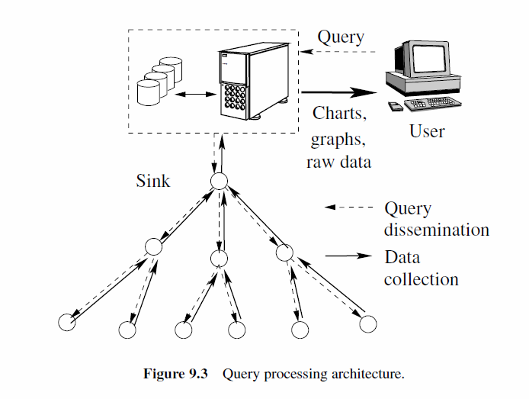
Query Processing
Query Representation
type = four-legged animal // detect animal location
interval = 20 ms // send back events every 20 ms
duration = 10 seconds // for the next 10 seconds
rect = [-100, 100, 200, 400] // from sensors within rectangle
Reply
type = four-legged animal // detect animal location
instance = elephant // instance of this type
location = [125,220] // mote location
intensity = 0.6 // signal amplitude measure
confidence = 0.85 // confidence in the match
timestamp = 01:20:40
The Sensor Query and Tasking Language (SQTL) has been developed to address this challenge through a procedural scripting language
(execute
:sender SINK
:receiver (:group NODE(1) :criteria TRUE)
:application-id 123
:language SQL
:content ( SELECT Max(getTemperature()) FROM ALL_NODES ))
Examples include TinyDB, COUGAR, etc.
TINYDB QUERY EXAMPLE:
ON EVENT bird-detect(loc):
SELECT AVG(light), AVG(temp), event.loc
FROM sensors as s
WHERE dist(s.loc, event.loc) < 10m
SAMPLE INTERVAL 2s FOR 30s

Slide 21
Grand Challenges

Slide 22
The main challenge is
ENERGY
ENERGY
ENERGY

Slide 23
Integration of Sensor Networks and the Internet
IETF 6LowPAN
IETF 6Tisch
CoAP
PANA
IPv6 for WSNs

Slide 24
Real-Time and Multimedia Communication
Intelligent and context aware camera systems
Event based camera applications.
Context extractıon from the images (fire, crime, protest, health hazard)

Slide 25
A better protocol stack for WSNs
6LowPAN
6Tisch
TSCH MAC
CoAP
Etc.

Slide 26
Synchronization and Localization
Efficient Synchronisation techniques
Localisation for physical internet (beacons etc.)
Better routing with better localisation
In-door tracking and direction finding.
Mapping of unknown environments.

Slide 27
Biggest Challenge Making IoT a reality.

Slide 29
Thank You for Your Attention.

